Slide 1


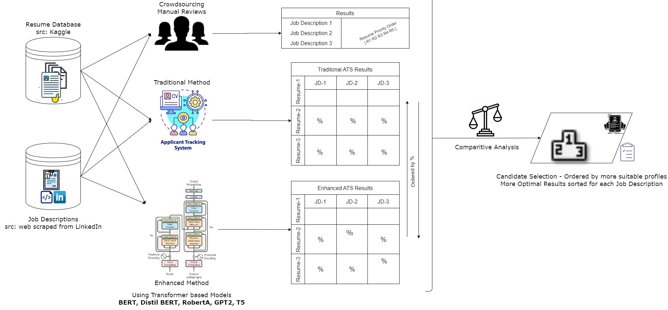
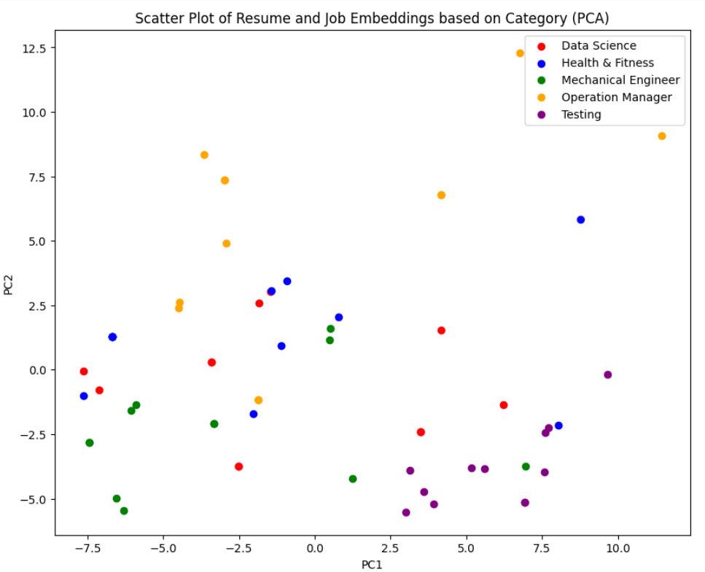
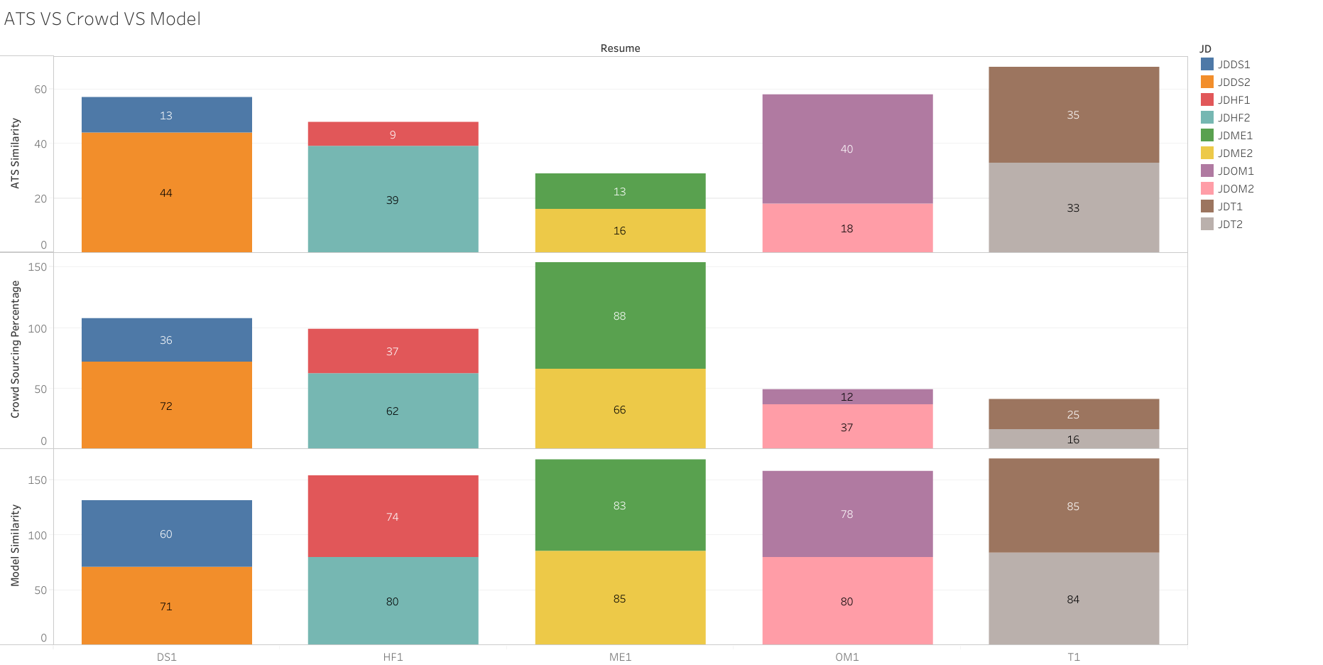
ATSIRE: Advanced Tracking System with Intelligent Resume Embeddings
Harshitha Pasem ¹, Sri Chandra Dronavalli ¹, Sai Tejesh Gonemadatala ²,Ravi Varma Kumar Bevara ¹ , Ting Xiao ^{1,2}
Department of Information Science, University of North Texas ¹; Department of Computer Science and Engineering, University of North Texas ²
Abstract
Workflow of Model
Conclusion
Enhanced Applicant Tracking Systems (ATS) are a powerful tool for organizations seeking to improve their recruitment processes. By leveraging advanced algorithms and deep-learning techniques, Enhanced ATS can accurately evaluate job candidates and match them to job descriptions, resulting in better hiring decisions and improved organizational outcomes. Additionally, Enhanced ATS helps to eliminate bias in the recruitment process and ensure that all candidates are evaluated fairly and consistently, which is crucial for creating a more diverse and inclusive workforce.
During economic downturns, companies can utilize an extremely efficient technique of analyzing resumes and job descriptions using embeddings. This advanced deep learning approach helps identify the most qualified candidates, reducing the risk of hiring individuals who lack competence. It ensures that only top-notch candidates are selected for crucial positions.
Motivation & Background
We recently conducted a study on crowd outsourcing, examining five job categories, each with ten job descriptions and fifty resumes. We evaluated each job description and resume and compared the results to those generated by a Traditional Applicant Tracking System (ATS). The Traditional ATS was found to be more effective than the crowd outsourcing method. However, we are currently researching the use of advanced deep learning models that incorporate embeddings to further improve the accuracy and efficiency of the Traditional ATS. We aim to enhance the recruitment process, resulting in better hiring decisions and organizational outcomes.
Future Work
To enhance our recruitment process, we need open communication and collaboration with recruitment teams to understand the job requirements and qualifications better. Reliable resumes and job descriptions are also essential for attracting highly qualified candidates. We can further improve the process by using advanced technologies like deep learning models, such as embeddings, to streamline recruitment and make better hiring decisions.
Fig 1: Workflow of model
Embeddings
Results
References
Parasurama, P., & Sedoc, J. (2021). Degendering Resumes for Fair Algorithmic Resume Screening. arXiv preprint arXiv:2112.08910.
Bondielli, A., & Marcelloni, F. (2021). On the use of summarization and transformer architectures for profiling résumés. Expert Systems with Applications, 184, 115521.
Acknowledgment
We express our gratitude to our advisors, Dr. Mark Albert and Dr. Ting Xiao, as well as our student advisor, Ravi Varma, for their invaluable guidance and support throughout our research endeavor. Their feedback and presentations provided us with a wealth of knowledge and greatly enhanced our research experience.
Fig 2: Embeddings of Resume and Job Description
Fig 3: Similarity scores extracted in comparison with job descriptions with respective resumes

